Slide 1

RockBUSTEr STEAlTH LLC
Analysis on increase revenue through market expansion
Prepared by: Smriti Bhattarai

Slide 2
Goal
What is the Goal ? Company is planning to increase its revenue through diversification into other high growing lucrative market by organic or inorganic tool
Why? To maintain or increase its market share as company facing competition from online and offline company
Key Questions:
What is the company concentration by revenue and by customer?
What is the most popular genre?
What are the key statistics of film rental?

Slide 3
MOVIE DATA OVERVIEW
Number of movies
1,000
Global Presence
109 countries and 599 cities
Release year for all movies
2006
Active Customers
599
Total Revenue
$61,312
Movie Categories
20

Slide 4
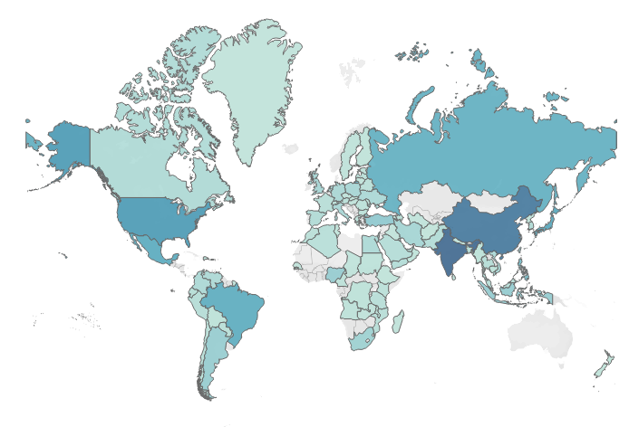
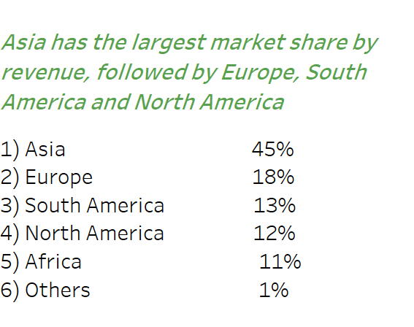
Approximate 63% of Rockbuster revenue comes from the Asia and Europe, so company can look for diversification into the US film market
Total Revenue by Country

Slide 5
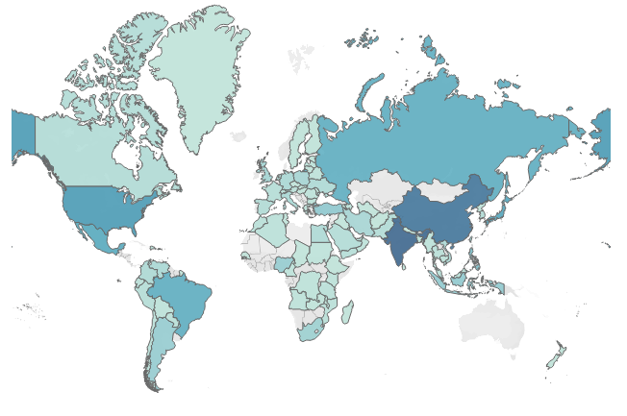
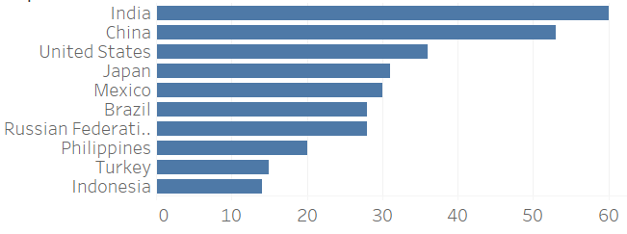
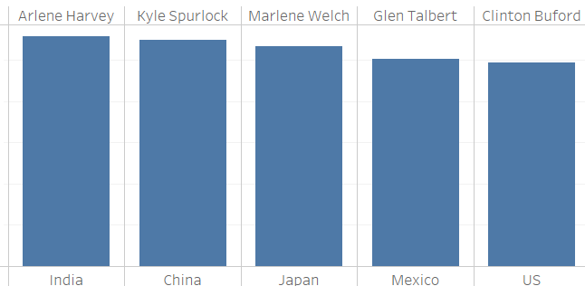
US is the third largest country by customer which gives Rockbuster great opportunity to penetrate US region more may be by loyalty program or marketing offers/campaign as it only accounts 12% of total revenue
Total Customer by Country
Top 10 Country by Customer
Top 5 Customer Within Top 5 Country

Slide 6
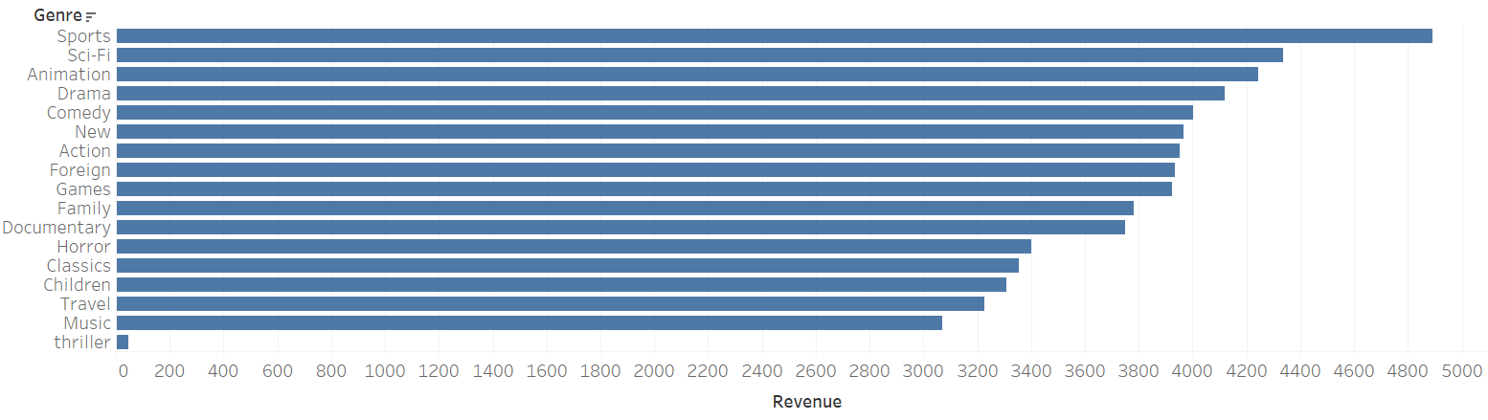
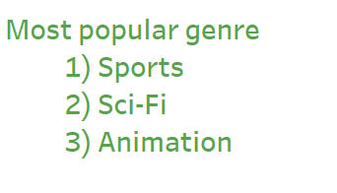

Sports, Sci-Fi and Animation are top three popular genre globally, where company can look for expansion
Total Revenue by Genre

Slide 7
Film Rental Key Statistics Overview
 | Minimum | Average | Maximum
Rental Rate ($) | 0.99 | 2.98 | 4.99
Rental Duration | 3.00 | 4.985 | 7.00
Replacement Cost ($) | 9.99 | 19.984 | 29.99
Length | 46.00 | 115.272 | 185.00

Slide 8
Conclusion
The US market looks good for expansion as US region only contributes 12% of revenue to its total revenue, and US market size is bigger in comparison to other regions
Rockbuster can launch loyalty programs as it has high customer base in the US market. So, they can leverage its existing customer base to build solid base foundation
Company can focus on launching various marketing campaign, discount schemes or other exciting offer (such as increased rental duration on joining) to increase its new customer base

Slide 9
Thank You
Data Immersion 3.10task | Tableau Public

